Slide 1
Sitecore CLI Features SITECORE USER GROUP PPT Sep 22, 2021

Slide 2
Sitecore CLI 4.0.0 Features
New
Updated
Indexing Plugin
Role Serialization
Serialization Notification Events
Publishing Plugin (publish targets)
Device Code Flow Authentication (auth url output)
ResourcePacking Plugin
Excluded Fields
Serialization Watch (Sitecore roles)

Slide 3
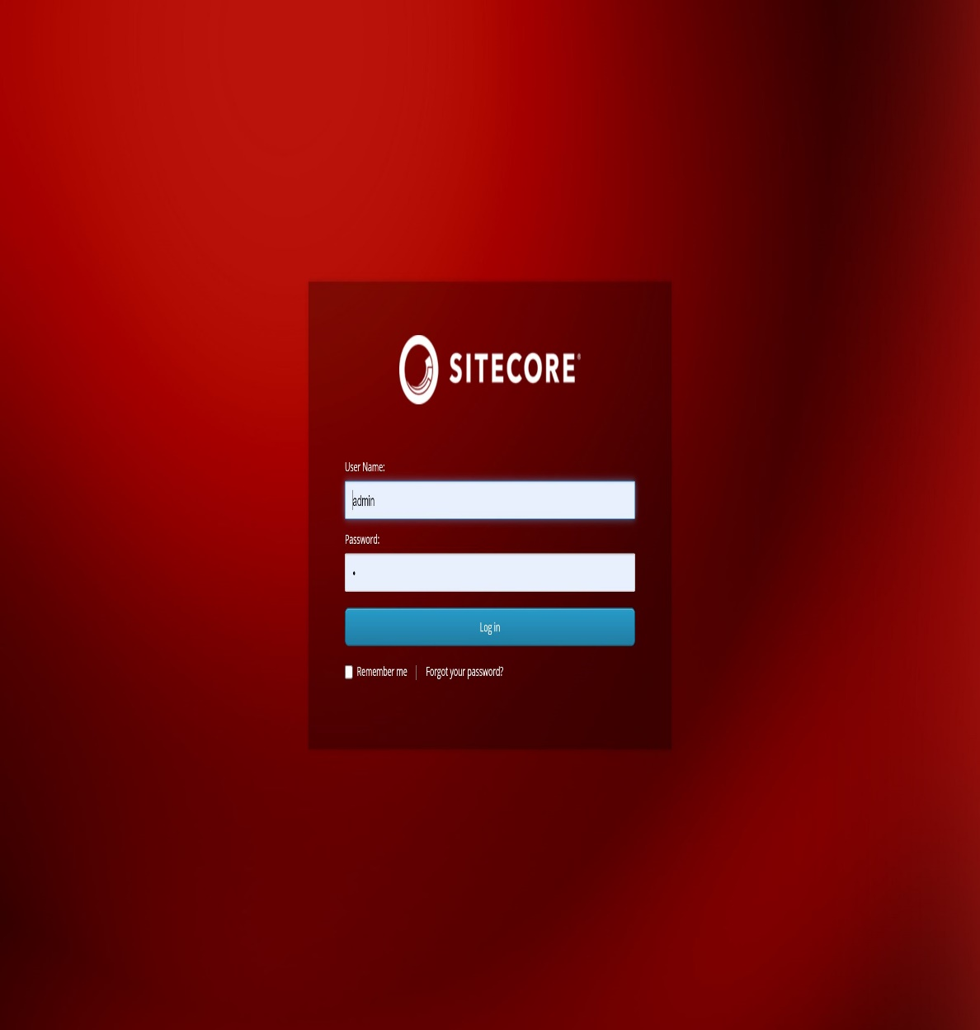
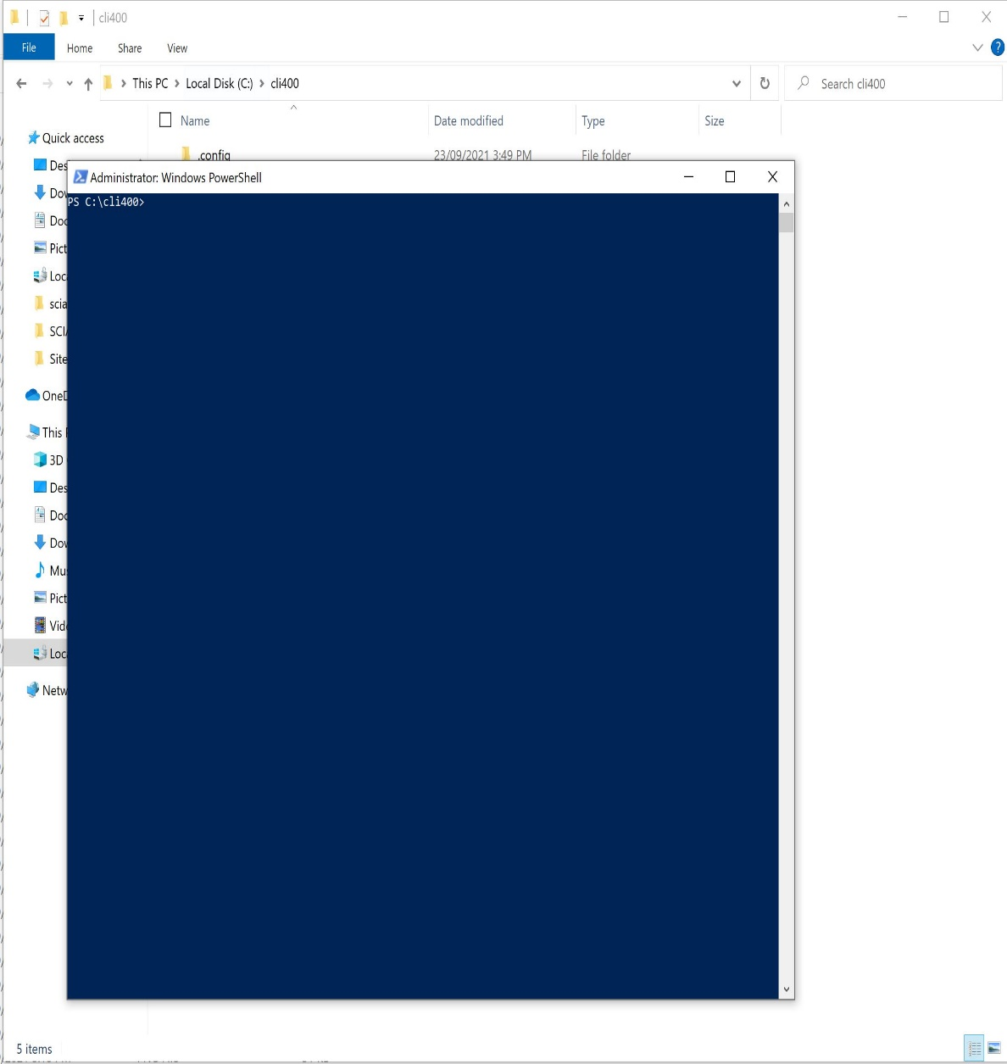
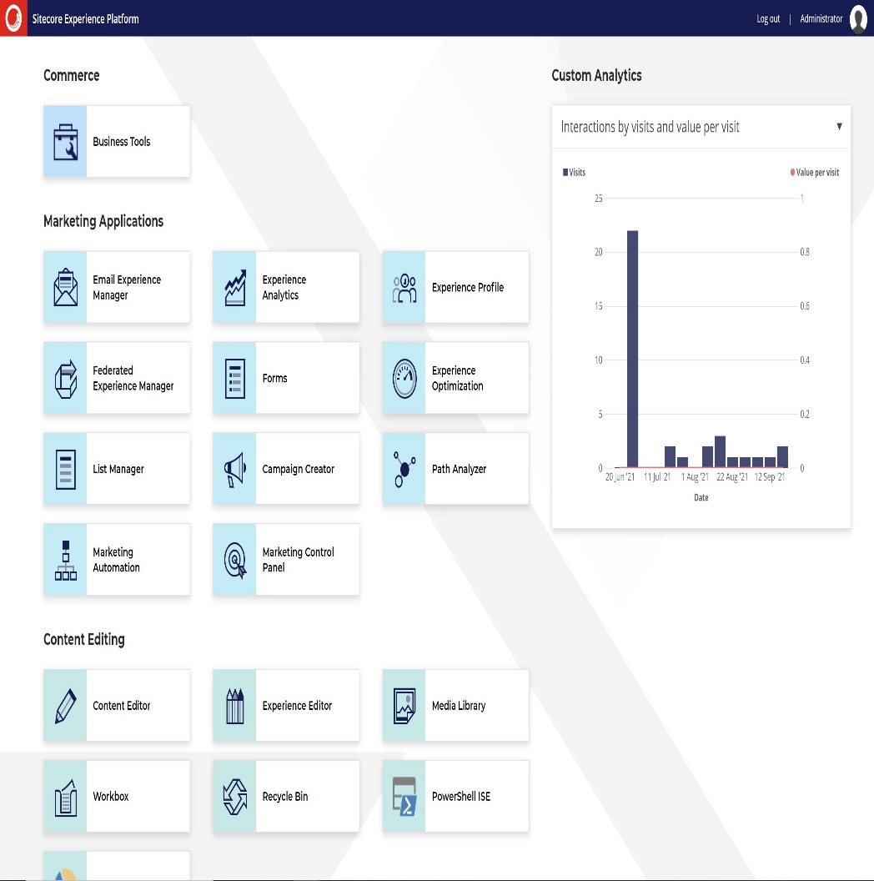
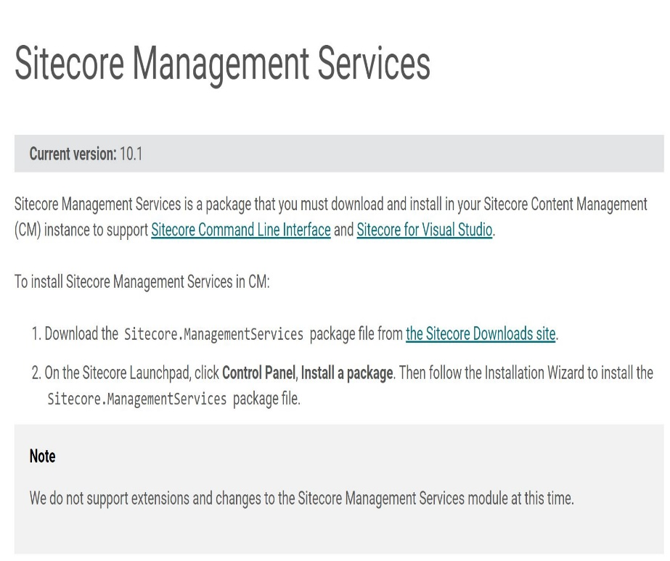

Sitecore CLI Architecture
Login Command
Access Token
Plugin
Command
Status
Sitecore Instance
File System

Slide 4
Sitecore CLI Plugin Setup
Dotnet new tool-manifest
Create .config\dotnet-tools.json
Dotnet local tool manifest file created
dotnet tool install Sitecore.CLI --add-source https://sitecore.myget.org/F/sc-packages/api/v3/index.json
Update CLI version in .config\dotnet-tools.json
Tool 'sitecore.cli' was successfully installed.
Dotnet sitecore init
Create schemas and sitecore.json
Plugin Helper couldn't find configuration file
dotnet sitecore plugin add -n <plugin name>
Download NuGet package to package_cache sub-folder
Successfully installed version <Ver no.> of plugin <plugin name>
User
PowerShell
File System

Slide 5
Sitecore - CLI Plugin Interaction
SMS 4.0.0
dotnet sitecore plugin add -n <plugin name>
Successfully installed version <Ver no.> of plugin <plugin name>
dotnet sitecore login --authority <id server URL> --cm <cm server URL> --allow-write true
Access and refresh tokens
Update user.json
dotnet sitecore index list
Display Index list
File System
PowerShell
Sitecore Instance

Slide 6
References
https://www.linkedin.com/pulse/sitecore-cli-version-400-now-available-justin-vogt/?trk=articles_directory
https://dev.sitecore.net/Downloads/Sitecore%20CLI/4x/Sitecore%20CLI%20400/Release%20Notes
https://doc.sitecore.com/en/developers/101/developer-tools/upgrade-the-sitecore-command-line-interface-to-version-4.html

